Slide 1

Predicting Attack for Network Intrusion Detection
Pari Manouchehri

Slide 2

Project Outline
Q: How accurately can packet be predicted as a Normal or Attack type given its attributes?
Introduction
EDA
Cleaning Dataset
Analyze Target and Features
Feature Engineering:
Data Preparation(one-hot, drop id, Attack_cat)
Applying PCA
Adding External resources
Modeling
Applying Logistic Regression , KNN Classifier, Random Forest Classifier, Gradient Boosting Classifier models
Optimizing Models
Scale
Applying Optimal Parameters by Using GridSearch
Important Features
Conclusion
Future Work

Slide 3

Introduction:
This dataset Is about Network Intrusion Detection. The dataset was taken from kaggle. It was published in 2015
The raw network packets of the unsw-nb15 is a comprehensive dataset for network intrusion detection systems which was created by the ixia perfect storm tool in the cyber range lab of the Australian center for cyber security (accs) for generating a hybrid of real modern normal activities and synthetic contemporary attack behaviors.
This dataset has nine types of attacks, it has features with the class label.
I used a partition from this dataset configured as a training set called, the number of records in the dataset is 175,341 from different types of attacks and normal.
Objective:
Exploring Data For Analyzing Network Intrusion Detection Attack.
Perform Modelling And Evaluate Their Learning To Predict The Anomaly Detection.

Slide 4
Exploratory Data Analysis(EDA)

Slide 5
Data Cleaning Summary
Replace
‘-’ to ‘else’
In “Service” Column Based on Note in Dataset
Keep
top 6 most
Common Protocols

Slide 6
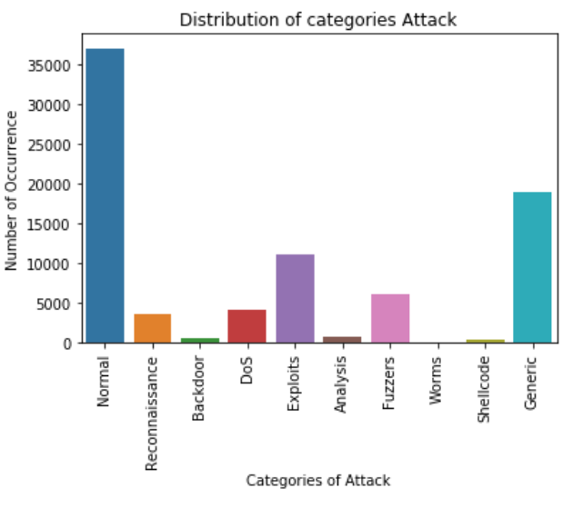
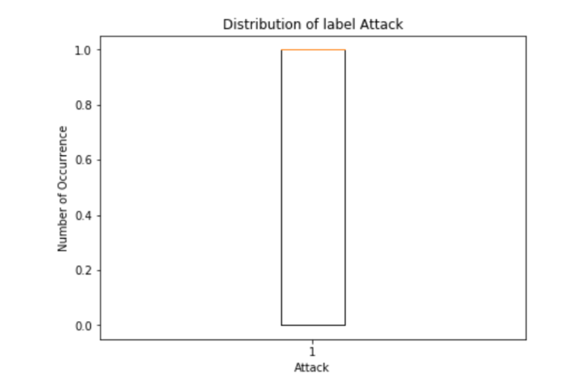
Distribution of Target Variable

Slide 7

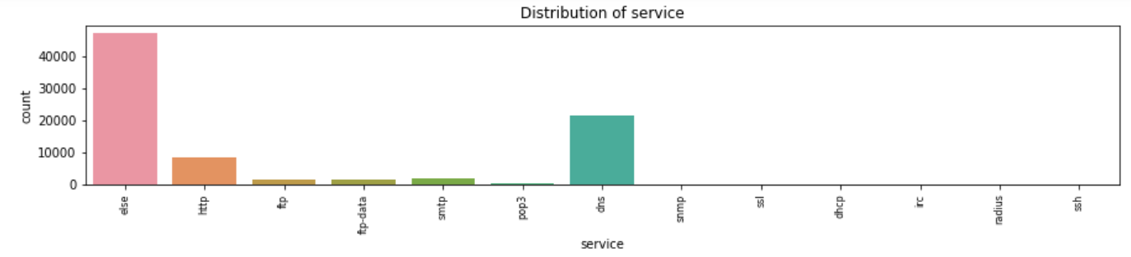
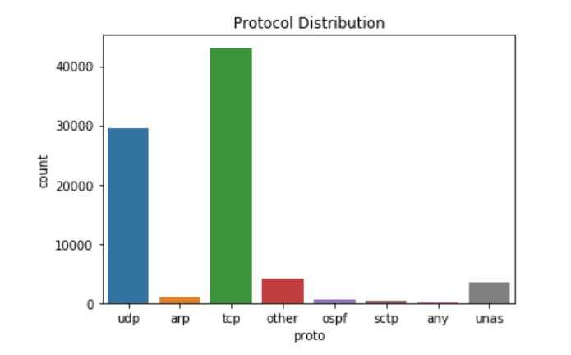
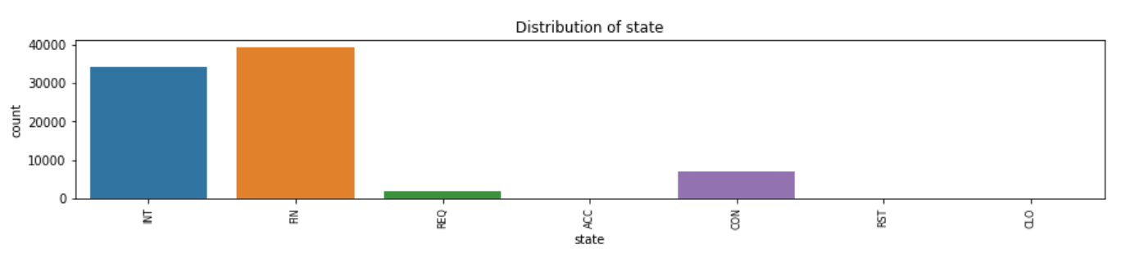
Protocol, Service & State Distribution

Slide 8
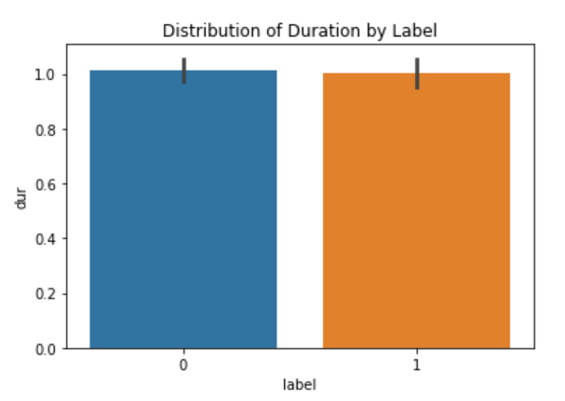
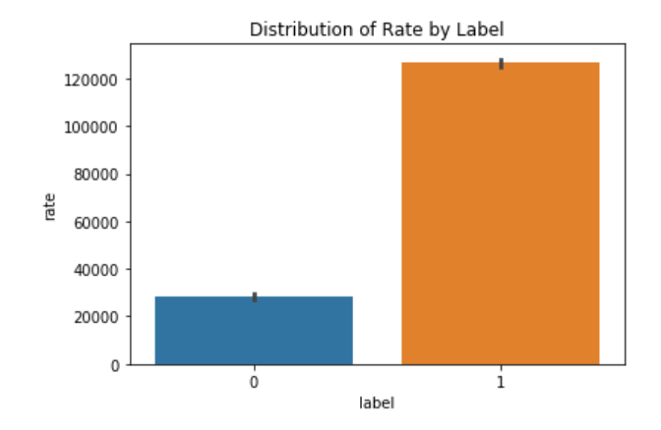
Rate & Duration Distribution by Label

Slide 9
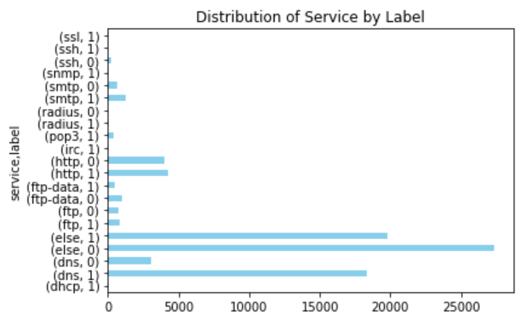
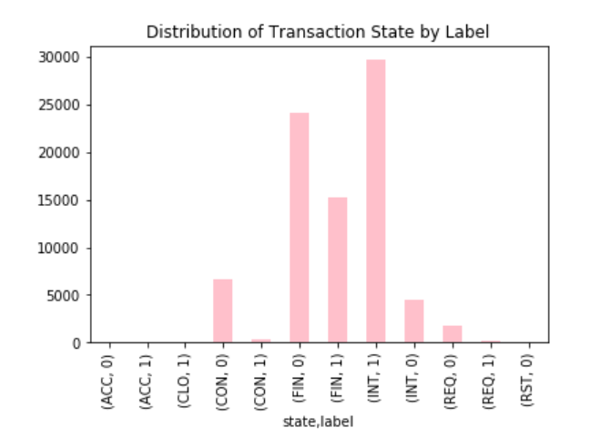
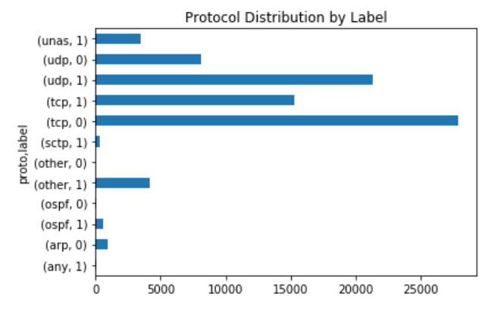
Service, Transaction State and Protocol Distribution by Label

Slide 10
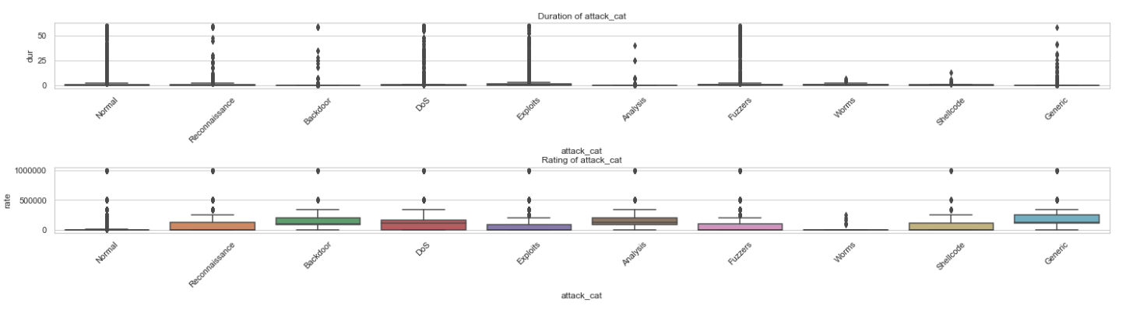
Distribution of Attack Categories BY Duration & Rate

Slide 11
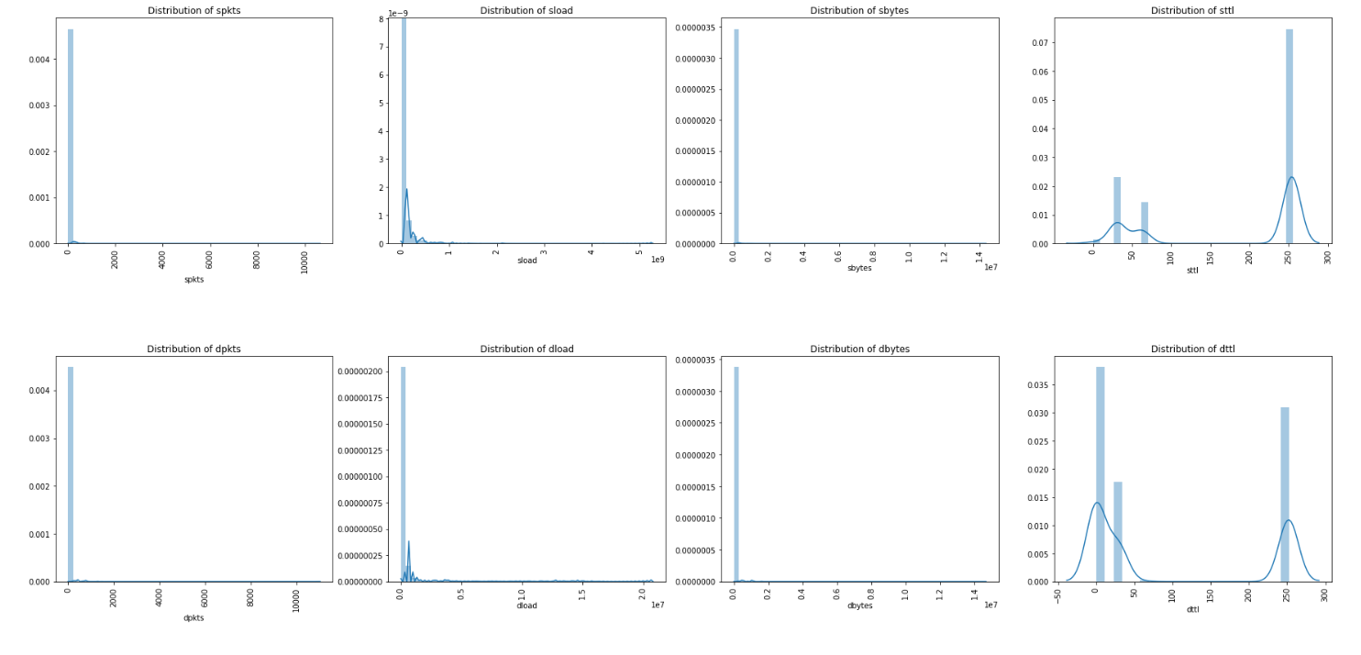
Distribution of Packet’s Transaction Data

Slide 12
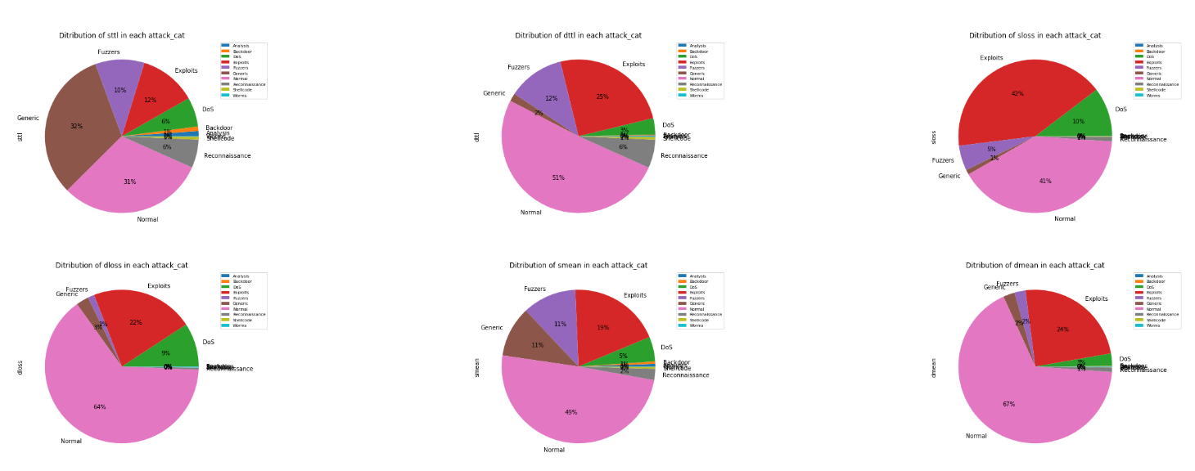
Distribution of Packet’s Time to Live, Lost

Slide 13
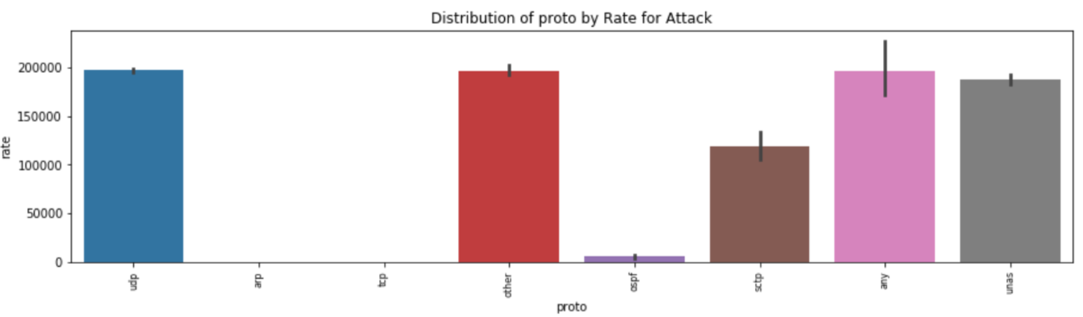
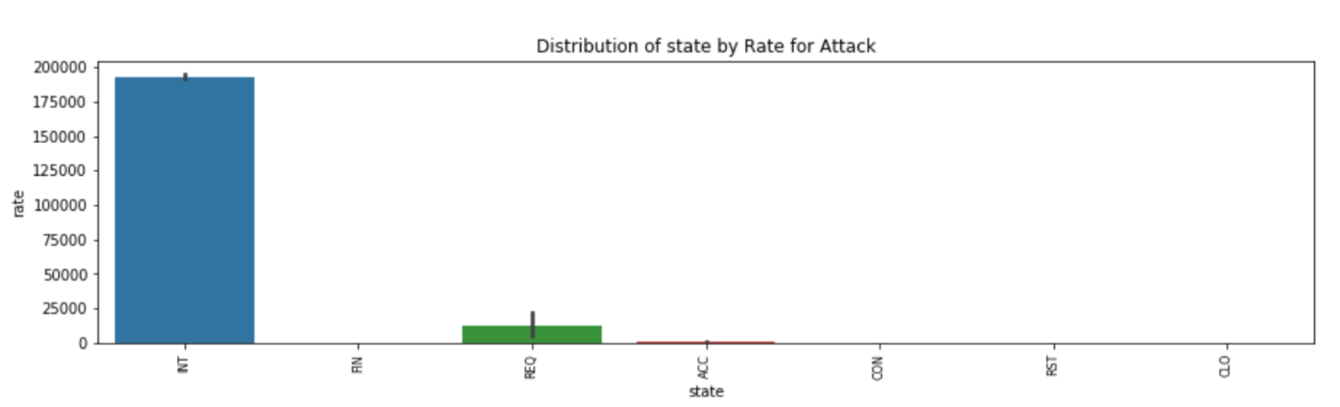
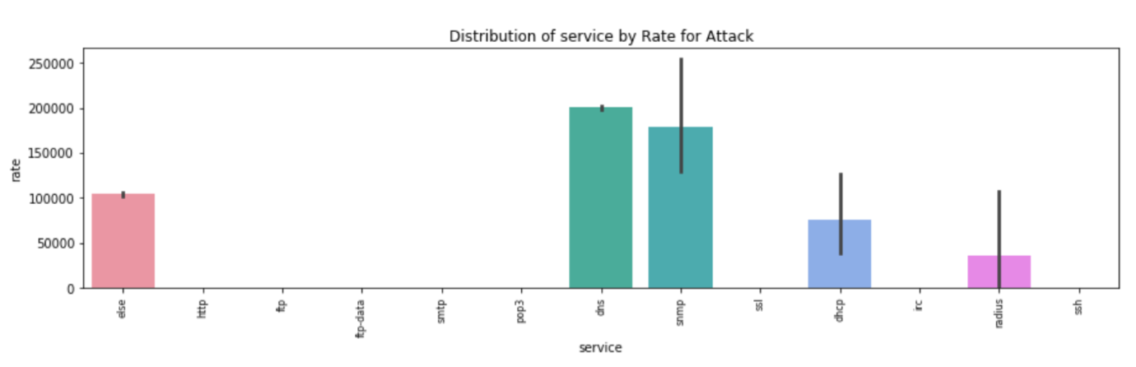
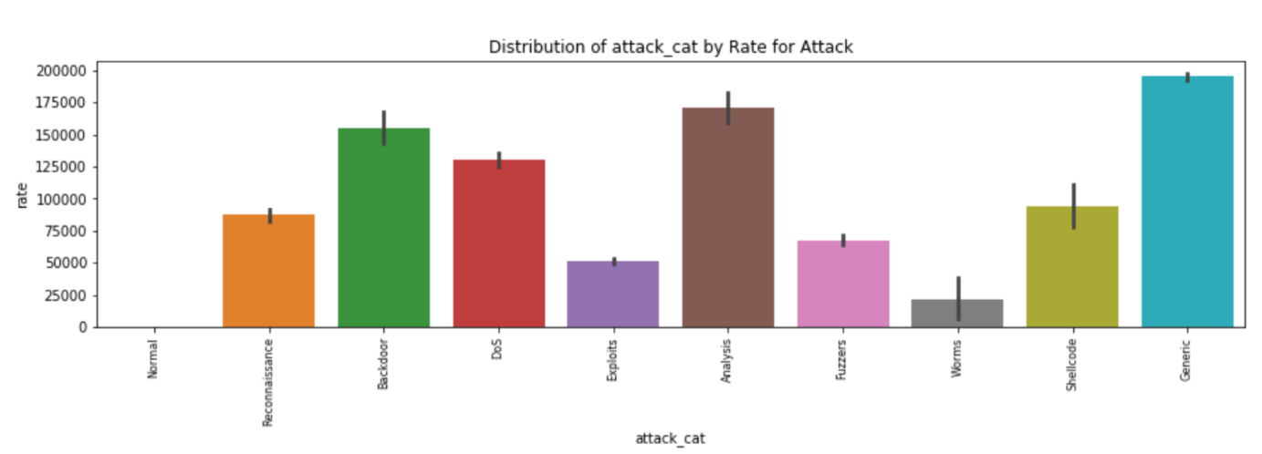
Distribution of Protocol, Service, State& Attack Category by Rate for Attack

Slide 14

Feature Engineering

Slide 15
Data Preparation
Applying
One-hot by using Dummy to Convert
Object-type Columns
to Numeric
Drop
ID and Attack_cat
from Dataset

Slide 16
Applying PCA
Find out the number of components that explain 90% of variance in the dataset.
Create Data Frame with PCA Components
Adding Target Variable
Applying Models

Slide 17
Adding External Resource
Load New Dataset
Cleaning New Dataset
Merge with the Original Dataset
Applying Models

Slide 18

Modeling

Slide 19
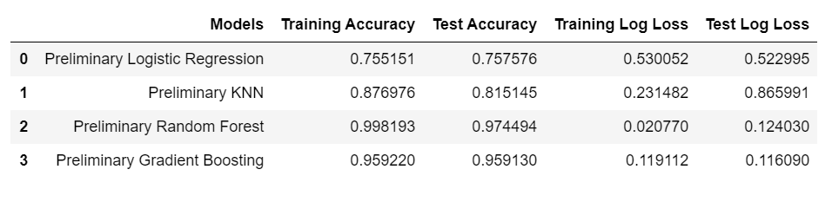
Preliminary Models Results
The KNN model has the most overfitting because the value of Test Accuracy is much lower than Training accuracy compared with other models.
Log Loss Scoring (uncertainly) Trends are Similar to the Accuracy.
The best Test model goes to Gradient Boosting model.
These Initial models are not Optimized; I only use the default hyperparameters.
Notes:
Sample note

Slide 20
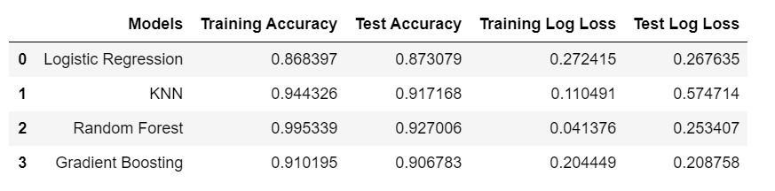
PCA Models Results
The Random Forest model has the most Overfitting because the value of Test Accuracy is much Lower than Training Accuracy Compared with other models.
Log Loss Scoring Trends are Similar to the Accuracy.
The best model goes to Gradient Boosting model.

Slide 21
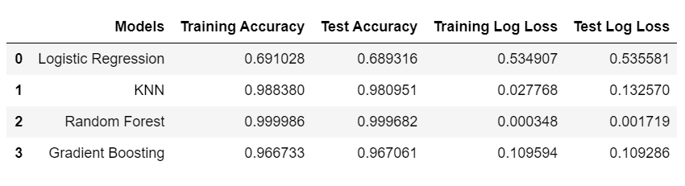
Modeling External Resource Results
The KNN has the most Overfitting because the value of Test Log Loss is much higher than Training compared with other models.
The best model goes to Gradient Boosting model.

Slide 22
Optimizing Models

Slide 23
Optimizing models
Scaling
Scaling data
GridSearchCV
Using GridSearchCV to find the best hyperparameters

Slide 24
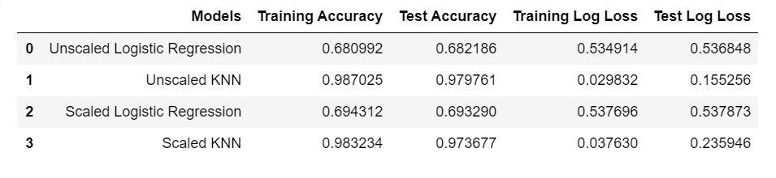
Scaling Results
For Logistic Regression and KNN model, Scaling does not seem to improve the model
Scaling is not necessary for tree-based model, So Random Forest and Gradient Boosting does not require feature scaling

Slide 25
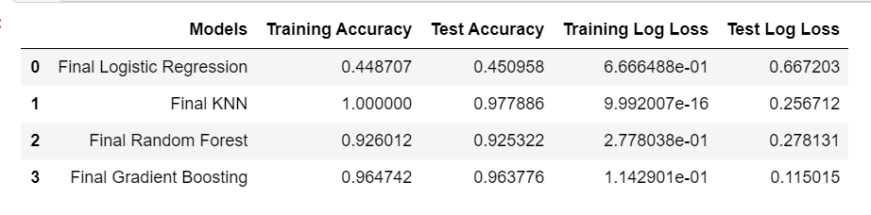
GridSearchCV Results
The KNN has the most Overfitting because the value of Test Accuracy is much Lower than Training Accuracy Compared with other models.
The best model goes to Gradient Boosting model.

Slide 26
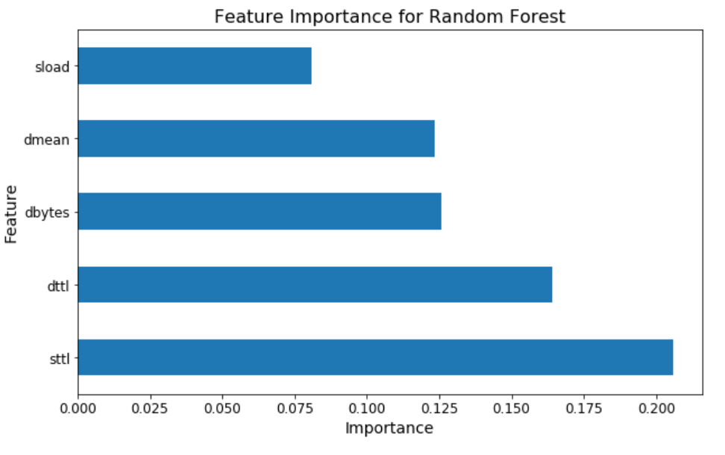
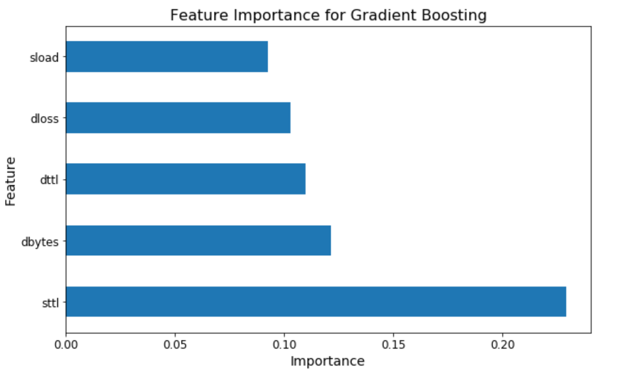
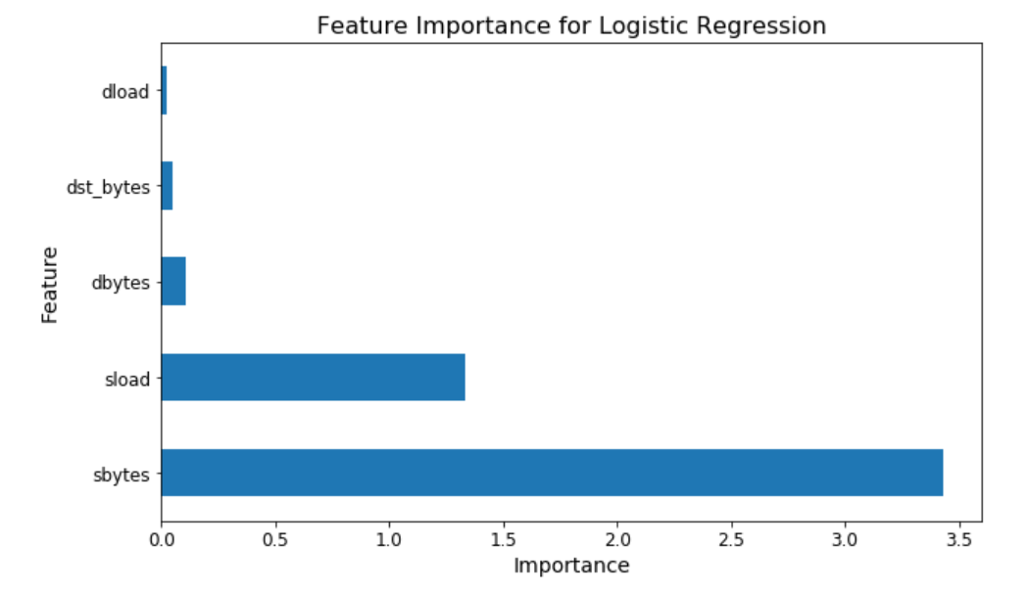
Feature Importance:
Logistic Regression and KNN models do not have built in feature importance functions.
Simple way to find Feature Importance for Logistic Regression is to multiply the Standard Deviation by the Coefficients of each Feature.
Could not discover a way to find Feature Importance for KNN, at least not without long runtimes.
Random Forest and Gradient Boosting have built in feature importance functions

Slide 27
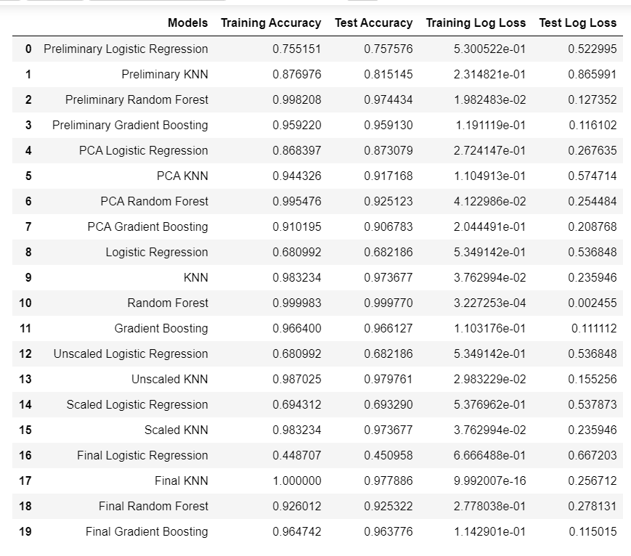
Conclusion
For all model, the Gradient Boosting model has the best results.
For Logistic Regression model, the best result is after applying PCA.
For KNN model, the best result is after applying GridSearchCV to find best parameters.
For Random Forest, the best result is after adding external resource.
For Gradient Boosting, the best result is after applying GridSearchCV to find best parameters.
The Important Feature For Logistic Regression is sbytes.
The Important Feature For Random Forest is sttl.
The Important Feature For Gradient Boosting is sttl.

Slide 28
Future Works
Adding another resource
Quality of the dataset could have been improved as well, for example dataset will includes port number,IP address,etc.
Analysis of the Attack categories and normal can be enriched to find the reason of Attack.
More data can be added to the analysis to broaden conclusions.
Newer data can be helpful in drawing better conclusions.

